Slide 1
Project 2
Predicting Baseball player salaries using Linear Regression

Slide 2
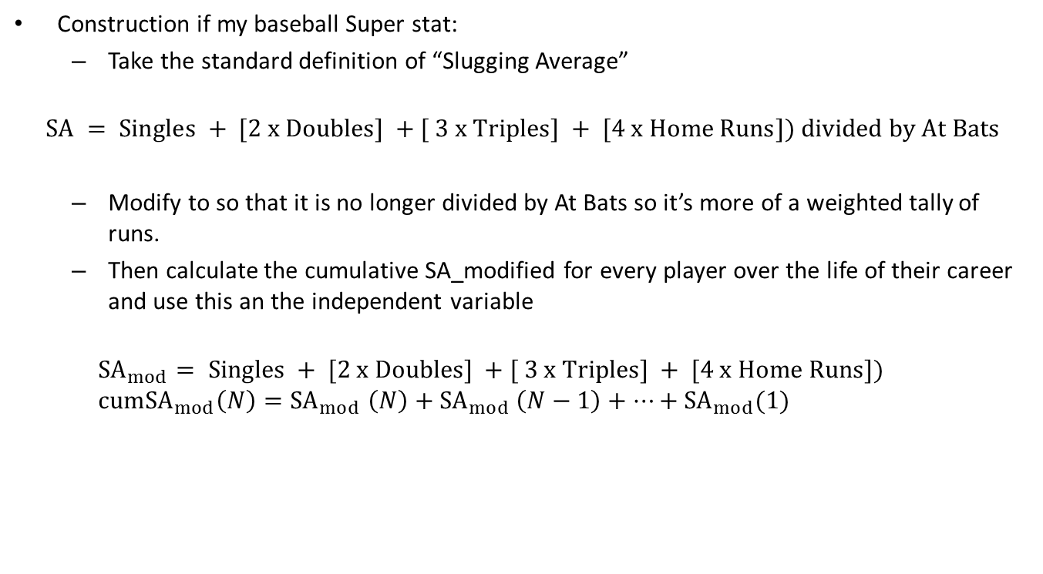
Project 2: Predicting Baseball Salaries
Construction if my baseball Super stat:
Take the standard definition of “Slugging Average”
$$SA = Singles + [2 x Doubles] +[ 3 x Triples] + [4 x Home Runs]) divided by At Bats$$
Modify to so that it is no longer divided by At Bats so it’s more of a weighted tally of runs.
Then calculate the cumulative SA_modified for every player over the life of their career and use this an the independent variable
$${SA}_{mod}= Singles + [2 x Doubles] +[ 3 x Triples] + [4 x Home Runs]) \\ cum{SA}_{mod}\left(N\right){=SA}_{mod}\left(N\right){+ SA}_{mod}\left(N−1\right)+…+{SA}_{mod}(1)$$

Slide 3
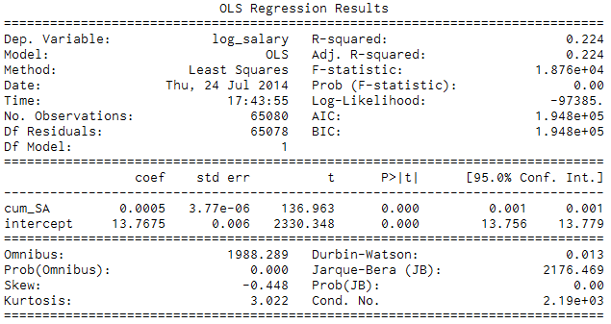
Project 2: Predicting Baseball Salaries
2-D Regression results:
Using cumSA_mod to predict the log(salary)
Using a random split of the data to conserve memory (with random numbers seeded)
Then dividing the remaining dataset 60/40 Train/Test data we obtain the following results:
Not bad for a single variable. R_2 = 23%, P_values = 0, and the training data gives us an average absolute error of $1,855,277. Still not bad for a single variable model

Slide 4
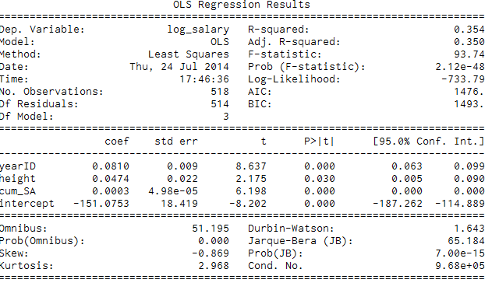
Project 2: Predicting Baseball Salaries
Regression results:
Let’s use a couple more reasonable variables and see how the results change:
I’m adding ‘height’ and the year the salary was recorded, ‘yearID’
A definite lift in adjusted R_squared and the average absolute error has dropped to $1,823,820. The cond number has shot through the roof , but you cant argue with the improved out of sample average absolute error

Slide 5
Project 2: Predicting Baseball Salaries
Regression results:
The yearID is highly correlated with our baseball superstat. So it looks like what we are really picking up with the stat is the increase in salary as we move through time.

